Slide 1



SHIDIMO INTERAUX PVT. LTD.
Quality…. an Obsession with us

Slide 2
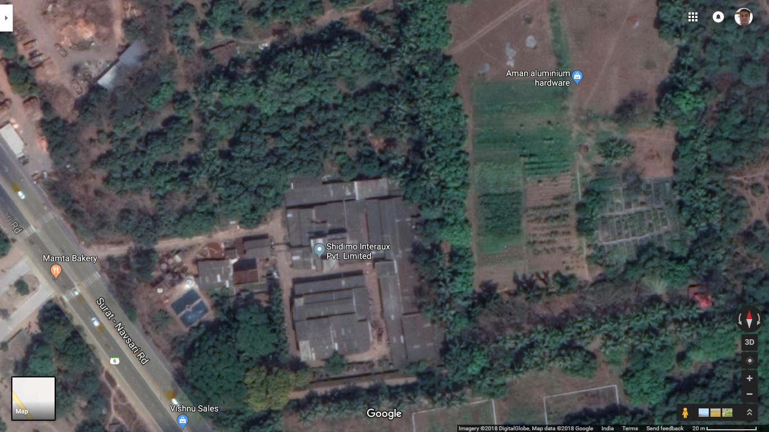
Agenda
About Company
Team
Products
Clientele
Contact Information

Slide 3
ABOUT US
Chromill Colour Industries (1979)
  Acid Dyes
Chromazo (1980)
  Acid Dyes
Shidimo Interaux Pvt. Ltd. (1983)
  Dye Intermediates
  Antistatic Oil
  Textile Chemicals

Slide 4
ABOUT US
Product List
  Acid Dyes
  Acid Milling Dyes
  Metal Complex Dyes
  Direct Dyes
  Solvent Dyes
  Fluorescent Pigments
  Textile Chemicals
  Antistatic Oil
  Detergent Powder

Slide 5

ABOUT US
Manufacturing: 1979
  Surat Market
  Domestic Market
    Agra, Kanpur, Kolkatta (Leather, Wool)
    Panipat, Amritsar, Delhi (Wool, Nylon)
    Bangalore (Silk)
    Chennai (Leather)
  Distributors (1983 - )
    Kanpur, Chennai, Bangalore

Slide 6
ABOUT US
Exports (1989)
U. K. | Spain
Netherlands | Italy
Taiwan | Korea
U. S. A. | Canada
Germany | Argentina
Japan | Haiti

Slide 7
ABOUT US
Today
  65 – 80% Exports
  Detergent Exports <10%
  Target of Detergent Exports >35% : 2 years

Slide 8
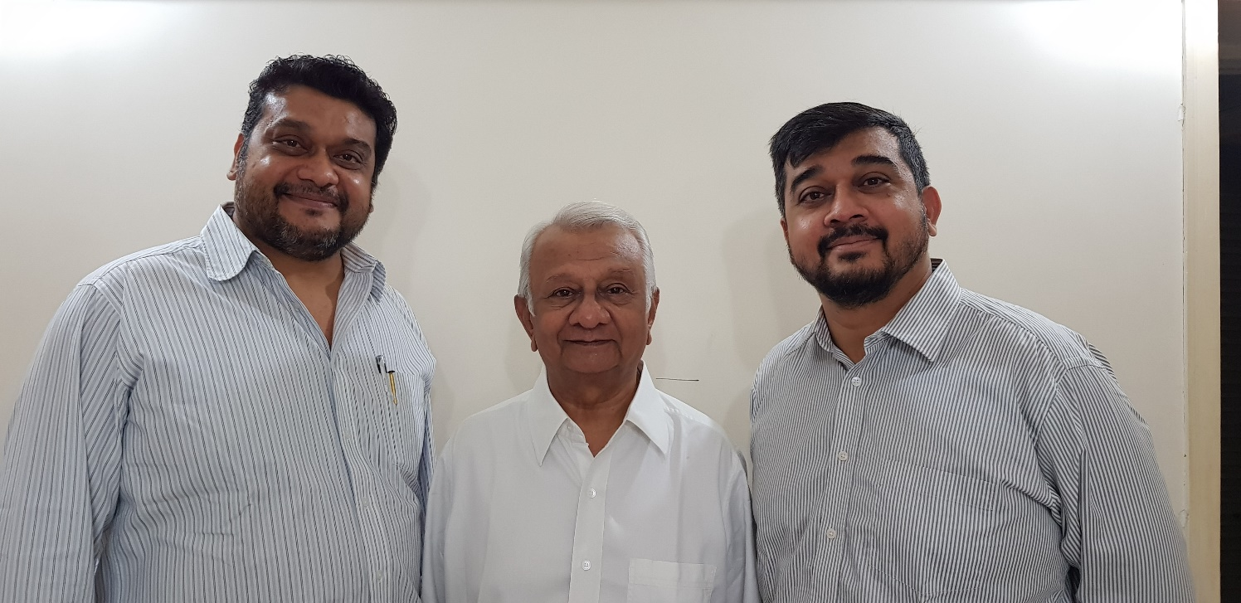
SHIDIMO INTERAUX PVT. LTD.
TEAM
Chemical engineers
Chemical analysts
Skilled & semi-skilled professionals
Sales and marketing professionals
LeftToRight: Vaishal Kapadia, Shirish Kapadia, Naitam Kapadia
DIRECTORS

Slide 9
SWACHHA DETERGENT
PRODUCTS
Launched Swachha detergent powder in 2012 in Surat, in two variants
  Swachha detergent powder (MRP Rs. 43\-)
  Swachha Super detergent powder (MRP Rs. 70/-)
Started exports with a 40’ fcl to Haiti
Starting exports to Africa in the coming quarter.
Launched new variants Swachha Activ+ & Swachha Ecomatic detergent powder for top load machines in August 2017

Slide 10
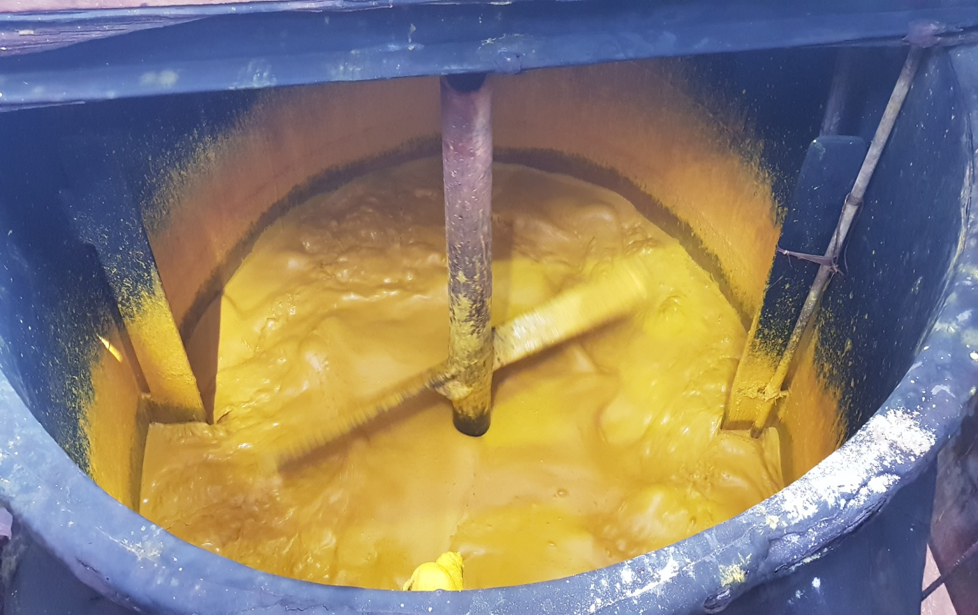
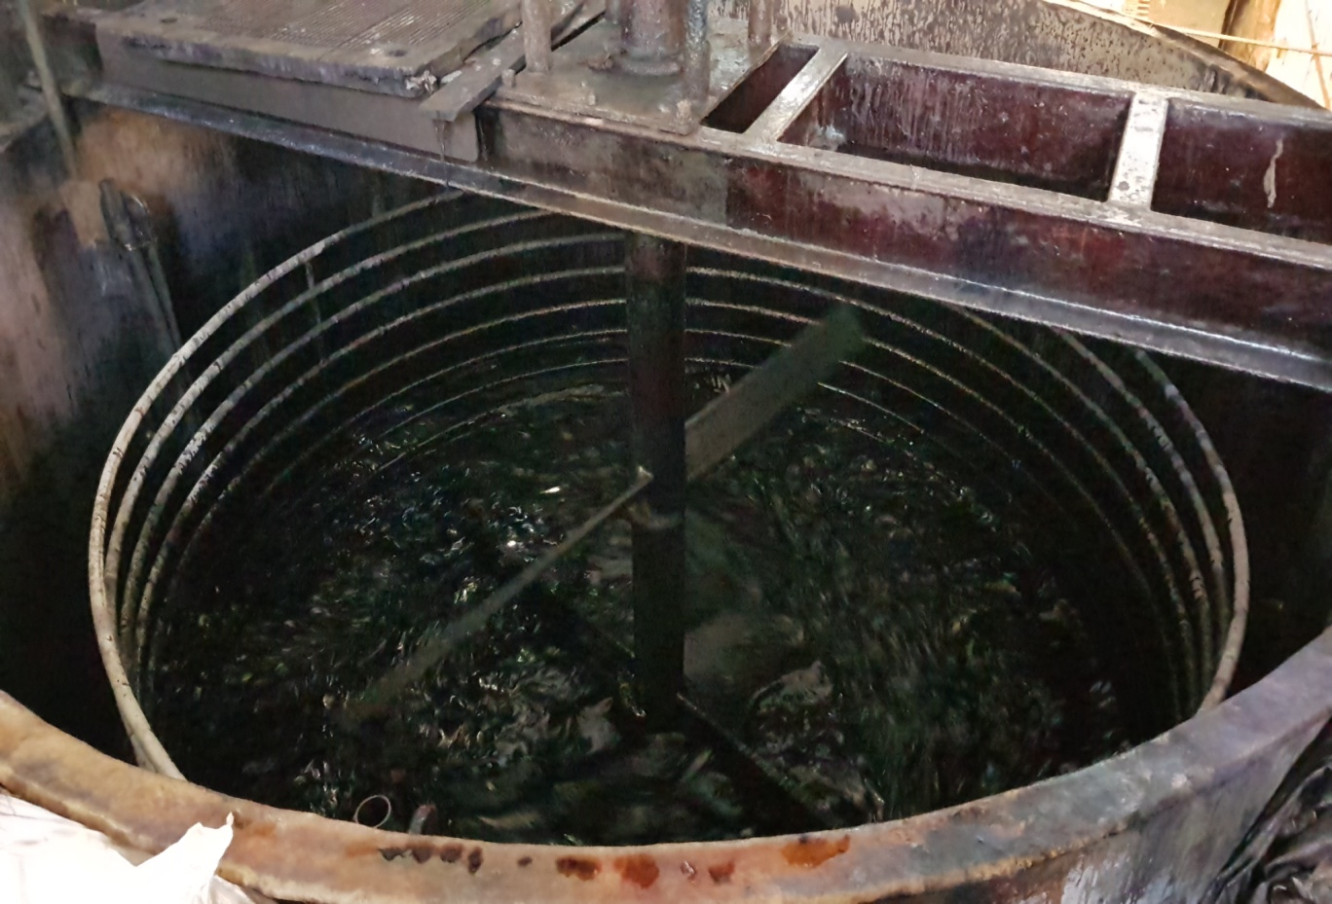
SHIDIMO INTERAUX PVT. LTD.
MANUFACTURING FACILITY
Current production capacity is 300 TPA

Slide 11
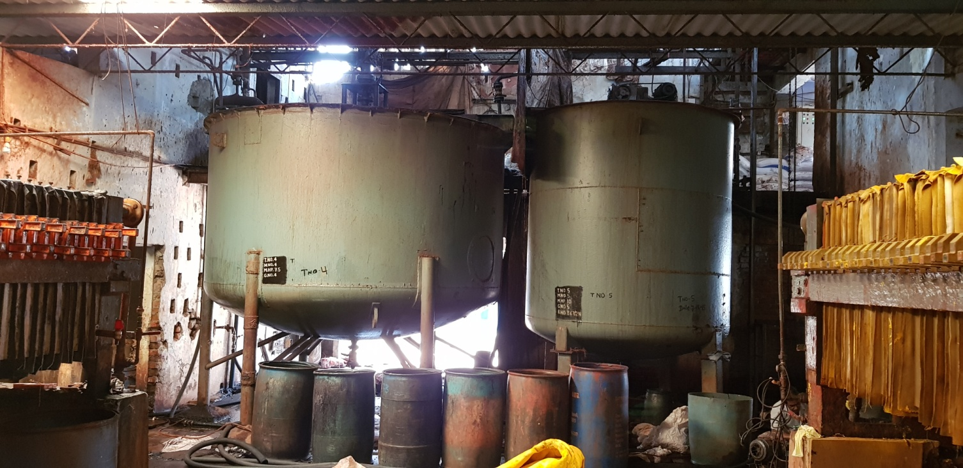
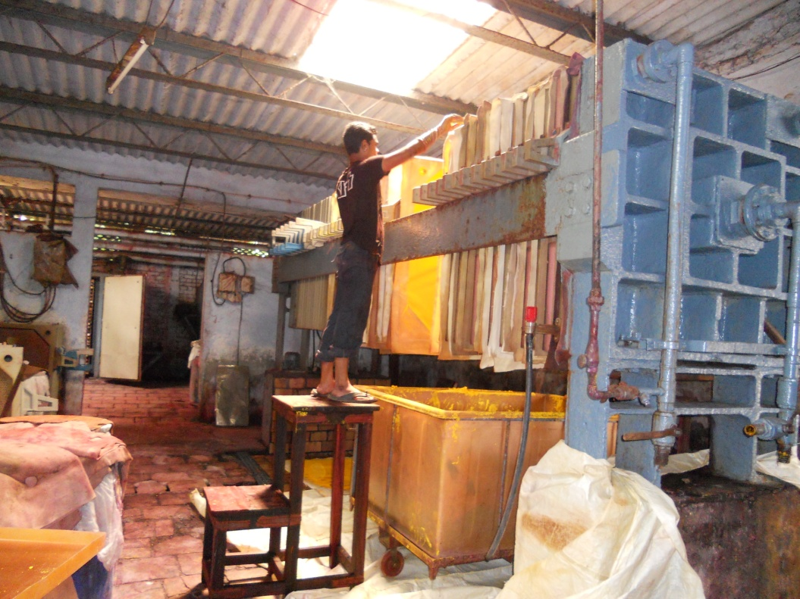
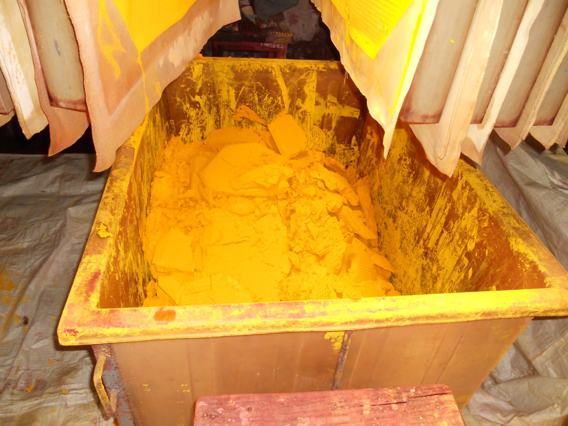
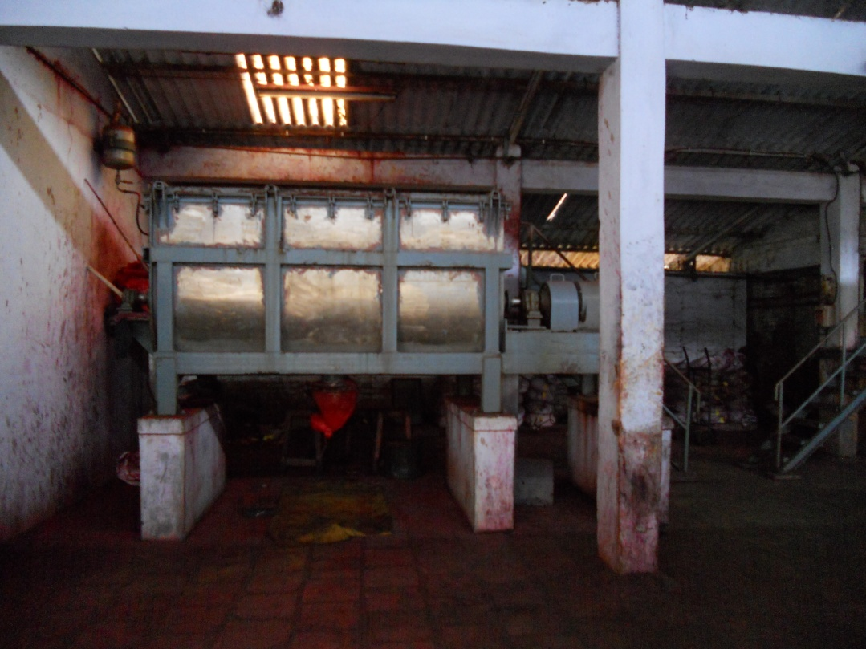

Slide 12
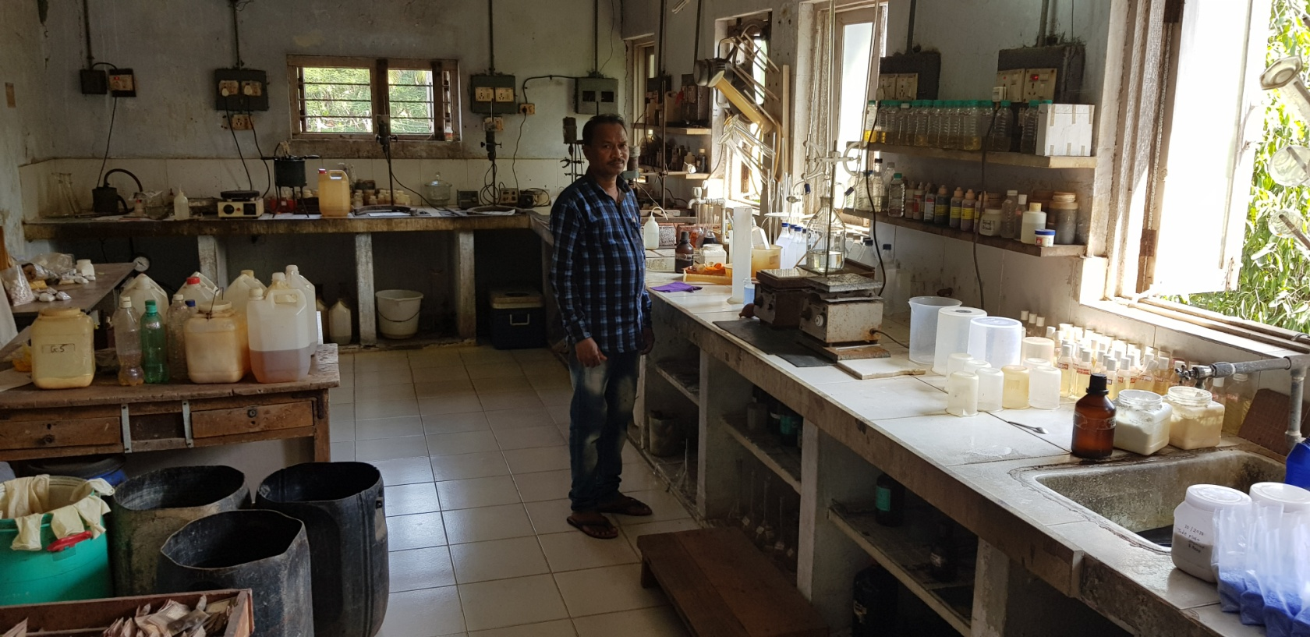
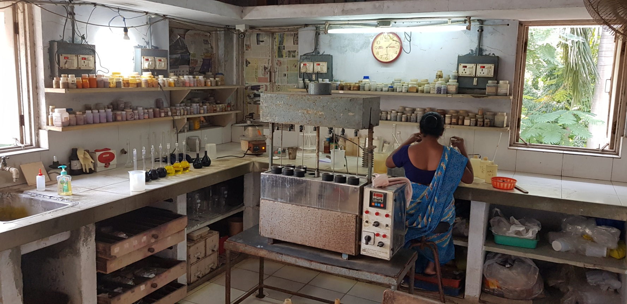
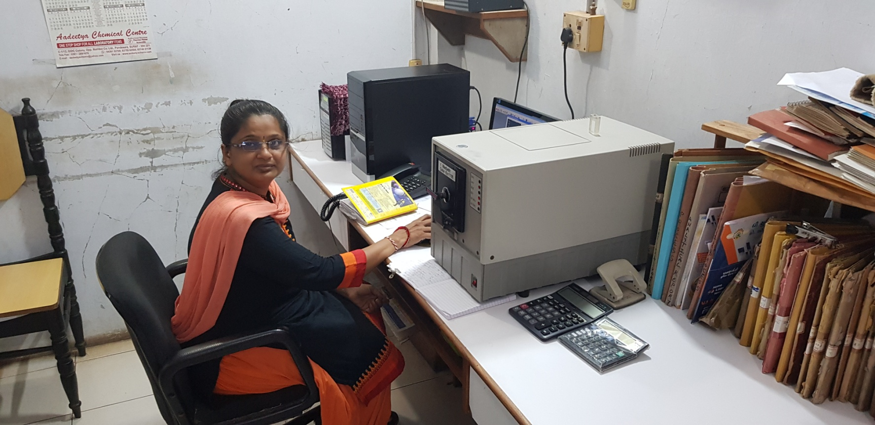

Slide 13
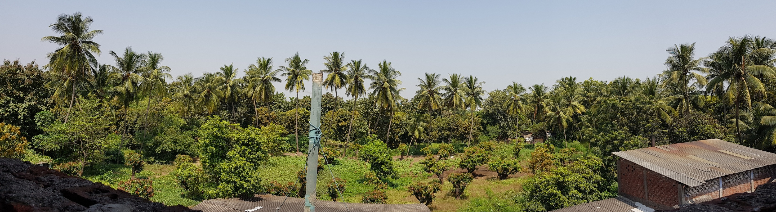
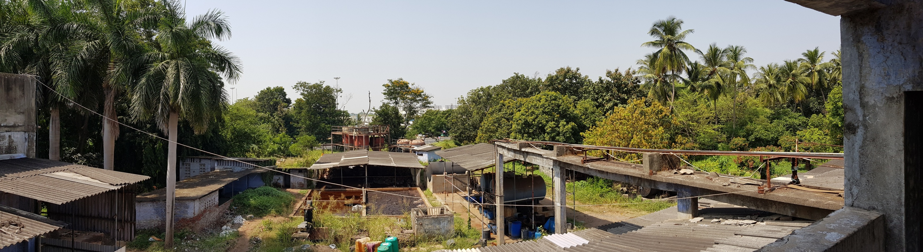

Slide 14
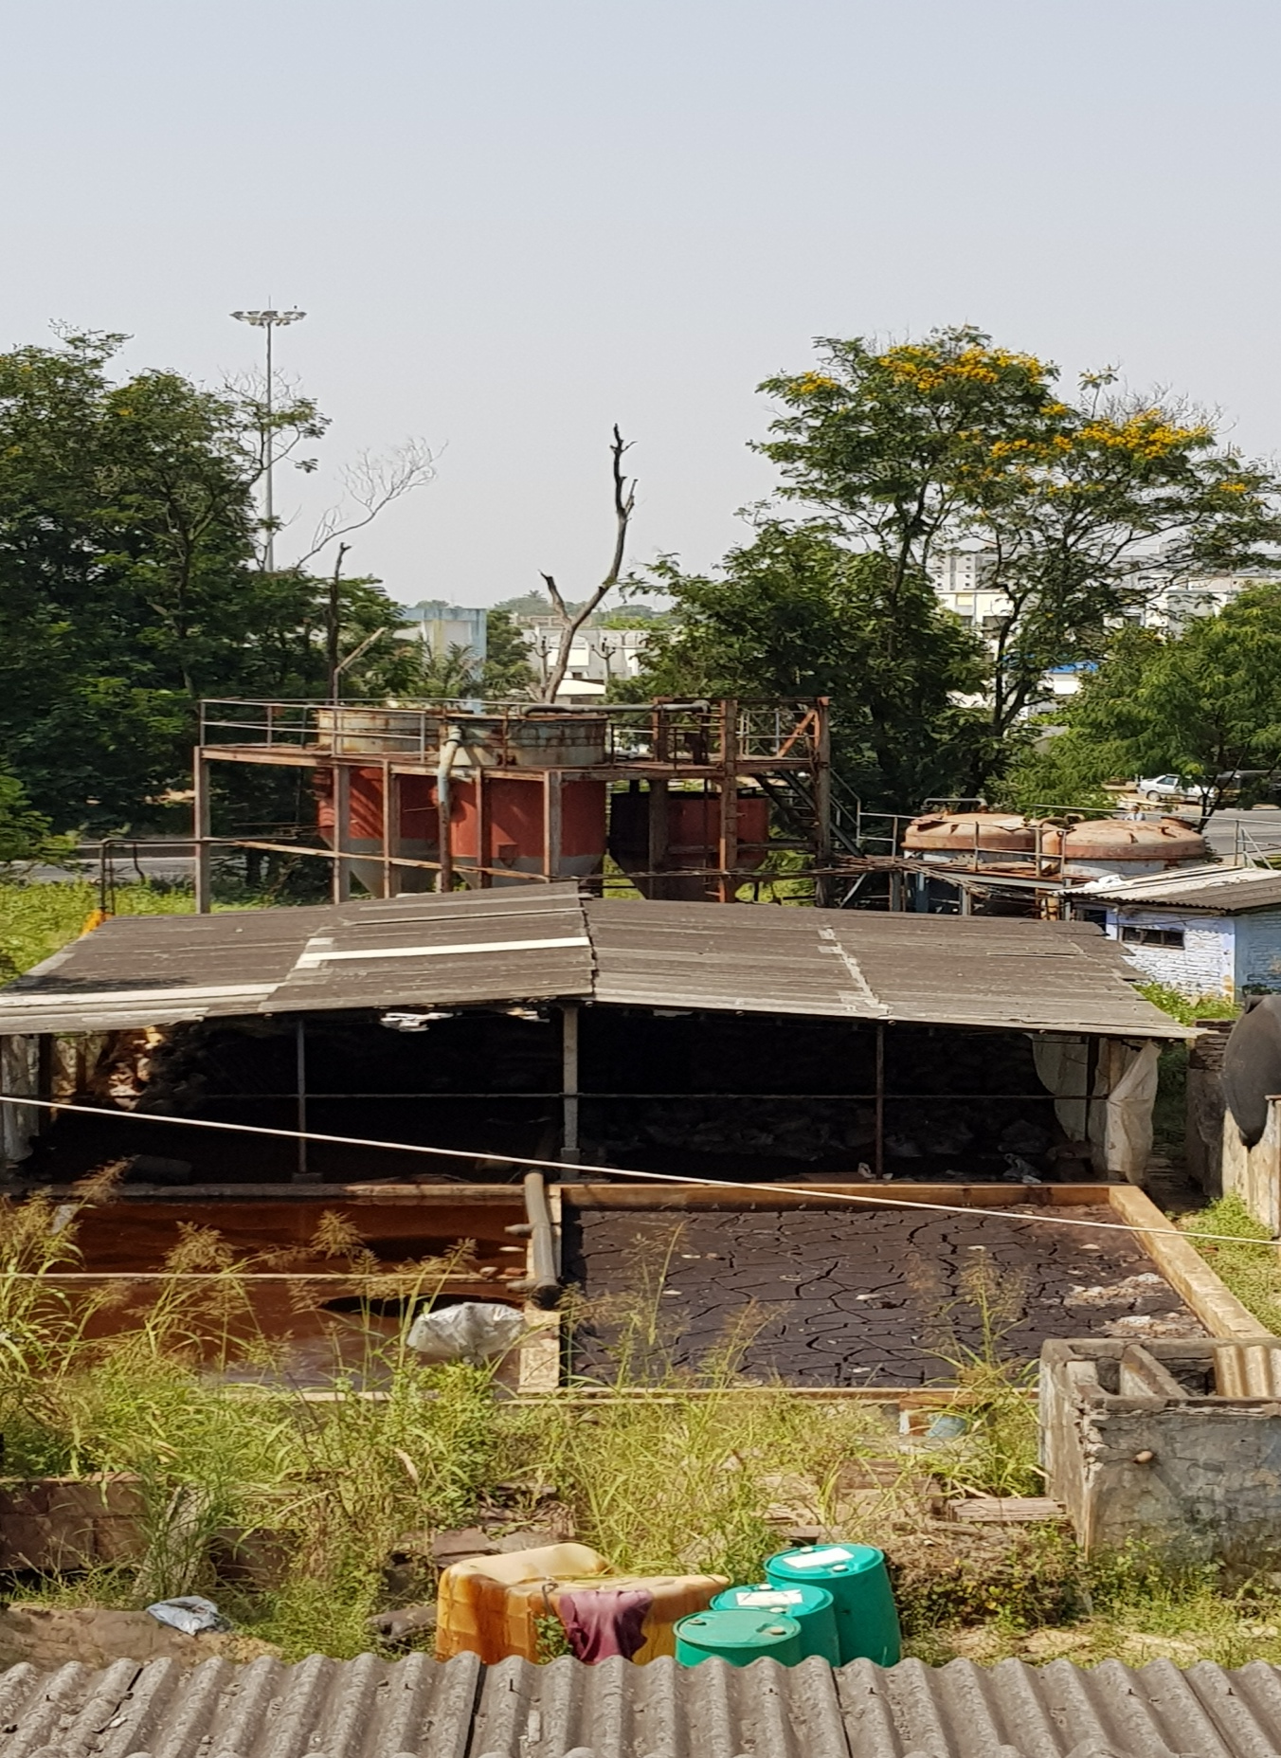

Slide 15
SHIDIMO INTERAUX PVT. LTD.
PRODUCT LIST
ACID YELLOW 17 | ACID YELLOW 19 | ACID YELLOW 42
ACID ORANGE 10 | ACID ORANGE 24 | ACID ORANGE 116
ACID RED 1 | ACID RED 97 | ACID RED 88
ACID RED 119 | ACID RED 131 | ACID RED 449
ACID VIOLET 54 | ACID BLUE 92 | ACID BLUE 113
ACID BLUE 359 | ACID BLACK 1 | ACID BLACK 24
ACID BLACK 194 | ACID BLACK 210 | ACID BLACK 234
MORDANT BLACK 11 | DIRECT RED 81

Slide 16
SHIDIMO INTERAUX PVT. LTD.
Certificate of analysis
Colour Index Name | : | Acid Blue 113
Name of Product | : | Shidomill Navy Blue S5R
C. I. # | : | 26360
Chemical Class | : | Disazo
CAS Number | : | 3351-05-1
Physical Appearance | : | Dark Blue Powder
Solubility | : | 7 SEC 60 GPL
Insolubles | : | 0.06%
pH (1% soln) | : | 7.39
Use | : | Wool, Silk, Nylon, Leather.

Slide 17
SHIDIMO INTERAUX PVT. LTD.
Certificate of analysis
Colour Index Name | : | Acid Orange 116
Name of Product | : | Shidomill Orange NR
C. I. # | : | -
Chemical Class | : | Trisazo
CAS Number | : | 12220-10-9
Physical Appearance | : | Dark Orange Powder
Solubility | : | 20 gpl@ 90ºc
Insolubles | : | 0.35 %
pH (1% soln) | : | 8.2
Use | : | Nylon, Silk, Leather & Wool

Slide 18
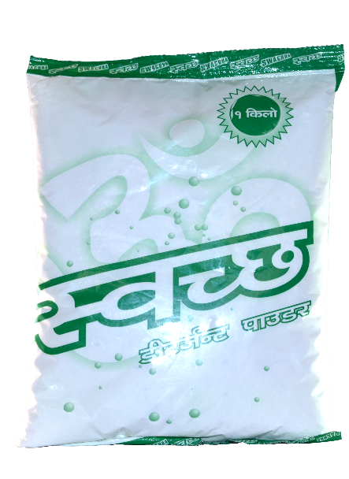






SHIDIMO INTERAUX PVT. LTD.

Slide 19



CSR CAMPAIGN
Swachha Surat
Swachha Tapi
Freedom through education
Round Table India's project "Freedom Through Education" to educate underprivileged children

Slide 20
DIGITAL PRESENCE
http://www.shidimo.com
http://swachha.in/
https://www.facebook.com/SwachhaDetergentPowder/
Skype: vaishalsk
Whatsapp: +919879759686 / +919879749686
Wechat: vaishalsk
Email: vaishal@shidimo.com / naitam@shidimo.com

